Slide 1
Pass 1 of Two Pass Assembler
Department: Computer Engineering
Group Number: TY_CS_C_G61
Group Members:
13 – Abbas Madhavaswala
79 – Devanshu Rathi
82 – Ripul Handoo
83 – Rishi Purohit
Subject: Compiler Design
Guided By – Prof. Anant Kaulage

Slide 2
Objectives
Understanding Assembly Language Fundamentals.
Symbol Table , Pool Table, Literal Table Resolution to resolve memory address.
Pass Based Compilation.
Creation of the Intermediate Code
Handling of Program Control Directives

Slide 3
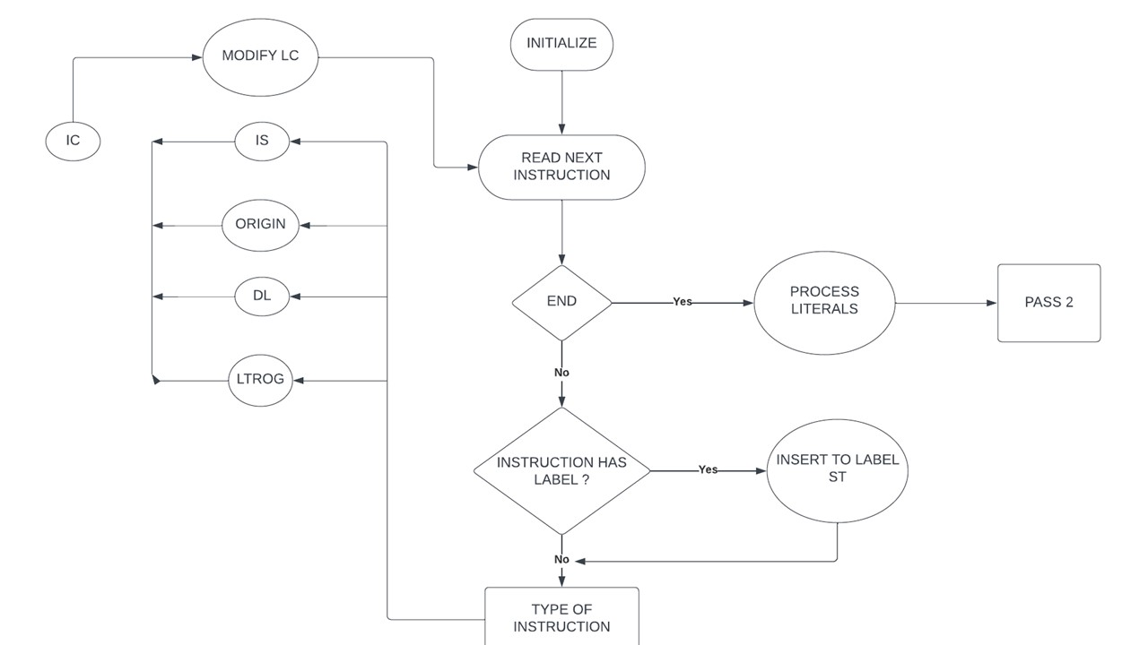
Flowchart

Slide 4
Mnemonics
'STOP':('00','IS’,0)
'ADD':('01','IS’,2)
'SUB':('02','IS’,2)
'MUL':('03','IS’,2)
'MOVER':('04','IS’,2)
'MOVEM':('05','IS’,2)
'COMP':('06','IS’,2)
'BC':('07','IS’,2)
'DIV':('08','IS’,2)
'READ':('09','IS’,1)
'PRINT':('10','IS’,1)
'LTORG':('05','AD’,0)
'ORIGIN':('03','AD’,1)
'START':('01','AD’,1)
'EQU':('04','AD’,2)
'DS':('01','DL’,1)
'DC':('02','DL’,1)
'END':('AD',0)}

Slide 5
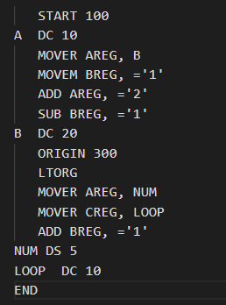
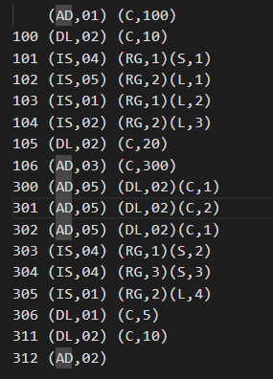
Example
Input Output

Slide 6

THANK YOU
This Photo by Unknown Author is licensed under CC BY-SA

